Slide 1

Software Vulnerability Analysis
(De)Serialization and You
Bradley Fisher ▪ Jiawei Hu ▪ Andrew Zitter
Notes:
Hi! For whoever is watching, thanks for your time! Today, we'll dive into an essential topic for software development and security—serialization and deserialization. This discussion will highlight their importance, usage, and associated risks, with demos and practical examples. Let’s begin!

Slide 2
Agenda
What is serialization and deserialization?
Uses of (de)serialization.
Examples of (de)serialization usage.
How (de)serialization works:
In Python
In Java
Deserialization from untrusted sources and its consequences.
Python and Java demos.
Defenses
Notes:
"Our agenda today is as follows:
We'll start with what serialization and deserialization are.
Next, explore their uses and common examples.
Then, dive deeper into how they work, specifically in Python and Java.
Discuss the dangers of deserialization from untrusted sources.
Finally, we’ll cover defenses and conclude with key takeaways. Stay tuned for demos and actionable insights!"

Slide 3
What is Serialization?
"The process whereby an object or data structure is translated into a format suitable for transfer over a network, or storage." -MDN Web Docs
In other words, serialization is the conversion of some object or structure in-memory into a format that's suitable for transfer or storage.
Deserialization is the reverse of serialization, taking the serialized form of an object, usually loaded from some form of I/O, and transforming it back into an object or structure in-memory.
Notes:
Serialization is the process of converting an object or data structure into a format suitable for transfer or storage, like a file or network transmission. According to MDN Web Docs, it's a way to translate objects into a format like JSON or binary.
Deserialization, the reverse process, takes serialized data—often from I/O operations—and reconstructs it into an in-memory object. Both processes are essential for modern applications

Slide 4
Why Serialize and Deserialize?
Configuration Files
Many programs store configuration data that needs to be remembered between program launches.
Serialization is used to take the settings in-memory and store them in a file.
Deserialization is used to take the file and restore the contents back into memory, usually adjusting program behavior after doing so.
Networking
Many programs require some form of networking, whether it's inter-process communication or outright sending data to other systems.
Serialization is used to take the in-memory data and put it in a format suitable to be sent across a network.
Deserialization is used to take the sent data and place it into memory where appropriate, usually performing some action afterwards.
Notes:
Why are these processes important? They enable:
Configuration management: Storing program settings in files for reuse.
Networking: Packaging data for communication between systems.
For example, when sending JSON data to an API or loading user preferences from a file, serialization and deserialization are at play, ensuring smooth data handling.

Slide 5
Common Serialization Formats
JavaScript Object Notation (JSON)
{
"dark_mode": true,
"gui_size": 1.0,
"username": "user123"
}
Extensible Markup Language (XML)
<settings>
<dark_mode>true</dark_mode>
<gui_size>1.0</gui_size>
<username>user123</username>
</settings>
Notes:
There are several popular formats for serialization:
JSON: Human-readable and widely used in web development.
XML: A more verbose, structured format often seen in older systems.
Each format serves specific needs, balancing readability and efficiency. For example, a JSON configuration might look like this
This simplicity makes JSON a favorite among developers."

Slide 6
Deserialization from Untrusted Sources
Untrusted sources
The network, files accessible by other programs, and standard input are all examples of untrusted sources for serialized objects.
A good rule of thumb is if it involves I/O, it's likely an untrusted source.
Consequences (assuming proper care isn't taken)
Best case: Graceful error as program copes with invalid data.
Worst case: System compromise as the deserialized object leads to code execution.
Notes:
Let's discuss a critical security vulnerability: deserialization from untrusted sources. This is a common but serious security risk that developers need to understand.
First, let's clarify what we mean by untrusted sources. These include:
Network connections
Files that other programs can access
Standard input streams
Think of it this way: if your application is receiving serialized data from any source you don't have complete control over, that source should be considered untrusted.
"Here's a simple way to identify potential risks: If your code involves any form of Input/Output operations, or I/O, it's likely dealing with an untrusted source. This includes:
Reading files
Network communications
User inputs
Inter-process communication
Now, let's look at what can happen if we don't handle deserialization properly. There are two main scenarios:
In the best case:
Your program encounters invalid data
It generates an error
But it handles this gracefully without crashing
However, in the worst case:
The deserialized object contains malicious code
This code gets executed during deserialization
This can lead to complete system compromise
An attacker could potentially take control of your system
The key point here is that deserialization of untrusted data is inherently dangerous. Always validate and sanitize data before deserialization, and when possible, avoid deserializing data from untrusted sources altogether.

Slide 7
Python Serialization
Python’s pickle module (de)serializes a Python object structure
Pickling converts a Python object into a byte stream; not human-readable
Unpickling converts the byte stream into an object instance
Currently version 5; backwards compatible with all previous versions
Pickle works in a tiny virtual machine
A Pickle stream is a series of interleaved data and instructions
Analogous to a program!
Human-readable pickle available using pickletools.dis()
Remove unused opcodes with pickletools.optimize()
Notes:
Python can use a number of methods to serialize and deserialize objects, but one popular option is the pickle module. This module takes a Python object structure and converts it into a byte stream – this is called Pickling. Unpickling, the reverse operation, evaluates that byte stream and returns the original object. This adds a layer of convenience because it can re-create complex objects without the need to first deserialize the data into, for example, a dictionary and then manually re-create the object. Pickle is currently at version 5, and a nice thing about it is that every version is backwards compatible. Each version adds new commands, or opcodes, without changing any existing ones.
Pickle actually works inside of a tiny virtual machine, and the pickled object itself is a combination of data and instructions – it works similarly to a traditional program. The byte stream isn’t human-readable, but we can use the pickletools module to see what steps are performed when unpickling an object back into its original form.

Slide 8
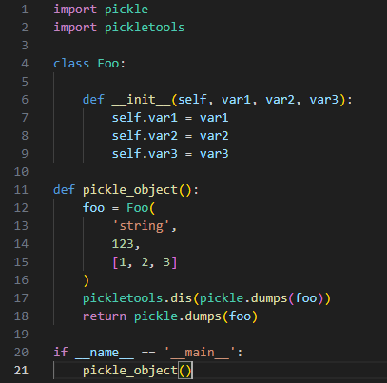
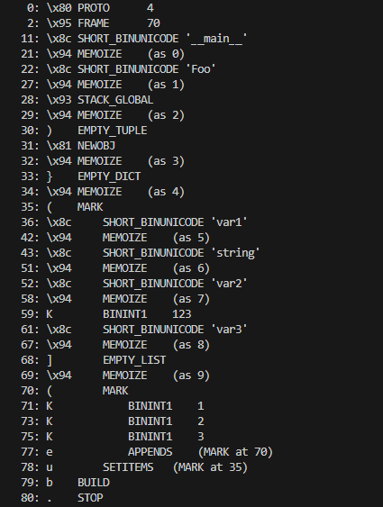
Python Serialization

Slide 9
Python Serialization
Pickle Stack
0: \x80 PROTO 4
2: \x95 FRAME 60
11: \x8c SHORT_BINUNICODE '__main__'
21: \x8c SHORT_BINUNICODE 'Foo'
26: \x93 STACK_GLOBAL
27: ) EMPTY_TUPLE
28: \x81 NEWOBJ
29: } EMPTY_DICT
30: ( MARK
31: \x8c SHORT_BINUNICODE 'var1'
37: \x8c SHORT_BINUNICODE 'string'
45: \x8c SHORT_BINUNICODE 'var2'
51: K BININT1 123
53: \x8c SHORT_BINUNICODE 'var3'
59: ] EMPTY_LIST
60: ( MARK
61: K BININT1 1
63: K BININT1 2
65: K BININT1 3
67: e APPENDS (MARK at 60)
68: u SETITEMS (MARK at 30)
69: b BUILD
70: . STOP
__main__

Slide 10
Python Serialization
Pickle Stack
0: \x80 PROTO 4
2: \x95 FRAME 60
11: \x8c SHORT_BINUNICODE '__main__'
21: \x8c SHORT_BINUNICODE 'Foo'
26: \x93 STACK_GLOBAL
27: ) EMPTY_TUPLE
28: \x81 NEWOBJ
29: } EMPTY_DICT
30: ( MARK
31: \x8c SHORT_BINUNICODE 'var1'
37: \x8c SHORT_BINUNICODE 'string'
45: \x8c SHORT_BINUNICODE 'var2'
51: K BININT1 123
53: \x8c SHORT_BINUNICODE 'var3'
59: ] EMPTY_LIST
60: ( MARK
61: K BININT1 1
63: K BININT1 2
65: K BININT1 3
67: e APPENDS (MARK at 60)
68: u SETITEMS (MARK at 30)
69: b BUILD
70: . STOP
Foo
__main__

Slide 11
Python Serialization
Pickle Stack
0: \x80 PROTO 4
2: \x95 FRAME 60
11: \x8c SHORT_BINUNICODE '__main__'
21: \x8c SHORT_BINUNICODE 'Foo'
26: \x93 STACK_GLOBAL
27: ) EMPTY_TUPLE
28: \x81 NEWOBJ
29: } EMPTY_DICT
30: ( MARK
31: \x8c SHORT_BINUNICODE 'var1'
37: \x8c SHORT_BINUNICODE 'string'
45: \x8c SHORT_BINUNICODE 'var2'
51: K BININT1 123
53: \x8c SHORT_BINUNICODE 'var3'
59: ] EMPTY_LIST
60: ( MARK
61: K BININT1 1
63: K BININT1 2
65: K BININT1 3
67: e APPENDS (MARK at 60)
68: u SETITEMS (MARK at 30)
69: b BUILD
70: . STOP
__main__.Foo

Slide 12
Python Serialization
Pickle Stack
0: \x80 PROTO 4
2: \x95 FRAME 60
11: \x8c SHORT_BINUNICODE '__main__'
21: \x8c SHORT_BINUNICODE 'Foo'
26: \x93 STACK_GLOBAL
27: ) EMPTY_TUPLE
28: \x81 NEWOBJ
29: } EMPTY_DICT
30: ( MARK
31: \x8c SHORT_BINUNICODE 'var1'
37: \x8c SHORT_BINUNICODE 'string'
45: \x8c SHORT_BINUNICODE 'var2'
51: K BININT1 123
53: \x8c SHORT_BINUNICODE 'var3'
59: ] EMPTY_LIST
60: ( MARK
61: K BININT1 1
63: K BININT1 2
65: K BININT1 3
67: e APPENDS (MARK at 60)
68: u SETITEMS (MARK at 30)
69: b BUILD
70: . STOP
(, )
__main__.Foo

Slide 13
Python Serialization
Pickle Stack
0: \x80 PROTO 4
2: \x95 FRAME 60
11: \x8c SHORT_BINUNICODE '__main__'
21: \x8c SHORT_BINUNICODE 'Foo'
26: \x93 STACK_GLOBAL
27: ) EMPTY_TUPLE
28: \x81 NEWOBJ
29: } EMPTY_DICT
30: ( MARK
31: \x8c SHORT_BINUNICODE 'var1'
37: \x8c SHORT_BINUNICODE 'string'
45: \x8c SHORT_BINUNICODE 'var2'
51: K BININT1 123
53: \x8c SHORT_BINUNICODE 'var3'
59: ] EMPTY_LIST
60: ( MARK
61: K BININT1 1
63: K BININT1 2
65: K BININT1 3
67: e APPENDS (MARK at 60)
68: u SETITEMS (MARK at 30)
69: b BUILD
70: . STOP
<__main__.Foo object>

Slide 14
Python Serialization
Pickle Stack
0: \x80 PROTO 4
2: \x95 FRAME 60
11: \x8c SHORT_BINUNICODE '__main__'
21: \x8c SHORT_BINUNICODE 'Foo'
26: \x93 STACK_GLOBAL
27: ) EMPTY_TUPLE
28: \x81 NEWOBJ
29: } EMPTY_DICT
30: ( MARK
31: \x8c SHORT_BINUNICODE 'var1'
37: \x8c SHORT_BINUNICODE 'string'
45: \x8c SHORT_BINUNICODE 'var2'
51: K BININT1 123
53: \x8c SHORT_BINUNICODE 'var3'
59: ] EMPTY_LIST
60: ( MARK
61: K BININT1 1
63: K BININT1 2
65: K BININT1 3
67: e APPENDS (MARK at 60)
68: u SETITEMS (MARK at 30)
69: b BUILD
70: . STOP
{}
<__main__.Foo object>

Slide 15
Python Serialization
Pickle Stack
0: \x80 PROTO 4
2: \x95 FRAME 60
11: \x8c SHORT_BINUNICODE '__main__'
21: \x8c SHORT_BINUNICODE 'Foo'
26: \x93 STACK_GLOBAL
27: ) EMPTY_TUPLE
28: \x81 NEWOBJ
29: } EMPTY_DICT
30: ( MARK
31: \x8c SHORT_BINUNICODE 'var1'
37: \x8c SHORT_BINUNICODE 'string'
45: \x8c SHORT_BINUNICODE 'var2'
51: K BININT1 123
53: \x8c SHORT_BINUNICODE 'var3'
59: ] EMPTY_LIST
60: ( MARK
61: K BININT1 1
63: K BININT1 2
65: K BININT1 3
67: e APPENDS (MARK at 60)
68: u SETITEMS (MARK at 30)
69: b BUILD
70: . STOP
MARK
{}
<__main__.Foo object>

Slide 16
Python Serialization
Pickle Stack
0: \x80 PROTO 4
2: \x95 FRAME 60
11: \x8c SHORT_BINUNICODE '__main__'
21: \x8c SHORT_BINUNICODE 'Foo'
26: \x93 STACK_GLOBAL
27: ) EMPTY_TUPLE
28: \x81 NEWOBJ
29: } EMPTY_DICT
30: ( MARK
31: \x8c SHORT_BINUNICODE 'var1'
37: \x8c SHORT_BINUNICODE 'string'
45: \x8c SHORT_BINUNICODE 'var2'
51: K BININT1 123
53: \x8c SHORT_BINUNICODE 'var3'
59: ] EMPTY_LIST
60: ( MARK
61: K BININT1 1
63: K BININT1 2
65: K BININT1 3
67: e APPENDS (MARK at 60)
68: u SETITEMS (MARK at 30)
69: b BUILD
70: . STOP
‘var3’
123
‘var2’
‘string’
‘var1’
MARK
{}
<__main__.Foo object>

Slide 17
Python Serialization
Pickle Stack
0: \x80 PROTO 4
2: \x95 FRAME 60
11: \x8c SHORT_BINUNICODE '__main__'
21: \x8c SHORT_BINUNICODE 'Foo'
26: \x93 STACK_GLOBAL
27: ) EMPTY_TUPLE
28: \x81 NEWOBJ
29: } EMPTY_DICT
30: ( MARK
31: \x8c SHORT_BINUNICODE 'var1'
37: \x8c SHORT_BINUNICODE 'string'
45: \x8c SHORT_BINUNICODE 'var2'
51: K BININT1 123
53: \x8c SHORT_BINUNICODE 'var3'
59: ] EMPTY_LIST
60: ( MARK
61: K BININT1 1
63: K BININT1 2
65: K BININT1 3
67: e APPENDS (MARK at 60)
68: u SETITEMS (MARK at 30)
69: b BUILD
70: . STOP
[]
‘var3’
123
‘var2’
‘string’
‘var1’
MARK
{}
<__main__.Foo object>

Slide 18
Python Serialization
Pickle Stack
0: \x80 PROTO 4
2: \x95 FRAME 60
11: \x8c SHORT_BINUNICODE '__main__'
21: \x8c SHORT_BINUNICODE 'Foo'
26: \x93 STACK_GLOBAL
27: ) EMPTY_TUPLE
28: \x81 NEWOBJ
29: } EMPTY_DICT
30: ( MARK
31: \x8c SHORT_BINUNICODE 'var1'
37: \x8c SHORT_BINUNICODE 'string'
45: \x8c SHORT_BINUNICODE 'var2'
51: K BININT1 123
53: \x8c SHORT_BINUNICODE 'var3'
59: ] EMPTY_LIST
60: ( MARK
61: K BININT1 1
63: K BININT1 2
65: K BININT1 3
67: e APPENDS (MARK at 60)
68: u SETITEMS (MARK at 30)
69: b BUILD
70: . STOP
MARK
[]
‘var3’
123
‘var2’
‘string’
‘var1’
MARK
{}
<__main__.Foo object>

Slide 19
Python Serialization
Pickle Stack
0: \x80 PROTO 4
2: \x95 FRAME 60
11: \x8c SHORT_BINUNICODE '__main__'
21: \x8c SHORT_BINUNICODE 'Foo'
26: \x93 STACK_GLOBAL
27: ) EMPTY_TUPLE
28: \x81 NEWOBJ
29: } EMPTY_DICT
30: ( MARK
31: \x8c SHORT_BINUNICODE 'var1'
37: \x8c SHORT_BINUNICODE 'string'
45: \x8c SHORT_BINUNICODE 'var2'
51: K BININT1 123
53: \x8c SHORT_BINUNICODE 'var3'
59: ] EMPTY_LIST
60: ( MARK
61: K BININT1 1
63: K BININT1 2
65: K BININT1 3
67: e APPENDS (MARK at 60)
68: u SETITEMS (MARK at 30)
69: b BUILD
70: . STOP
3
2
1
MARK
[]
‘var3’
123
‘var2’
‘string’
‘var1’
MARK
{}
<__main__.Foo object>

Slide 20
Python Serialization
Pickle Stack
0: \x80 PROTO 4
2: \x95 FRAME 60
11: \x8c SHORT_BINUNICODE '__main__'
21: \x8c SHORT_BINUNICODE 'Foo'
26: \x93 STACK_GLOBAL
27: ) EMPTY_TUPLE
28: \x81 NEWOBJ
29: } EMPTY_DICT
30: ( MARK
31: \x8c SHORT_BINUNICODE 'var1'
37: \x8c SHORT_BINUNICODE 'string'
45: \x8c SHORT_BINUNICODE 'var2'
51: K BININT1 123
53: \x8c SHORT_BINUNICODE 'var3'
59: ] EMPTY_LIST
60: ( MARK
61: K BININT1 1
63: K BININT1 2
65: K BININT1 3
67: e APPENDS (MARK at 60)
68: u SETITEMS (MARK at 30)
69: b BUILD
70: . STOP
[1, 2, 3]
‘var3’
123
‘var2’
‘string’
‘var1’
MARK
{}
<__main__.Foo object>

Slide 21
Python Serialization
Pickle Stack
0: \x80 PROTO 4
2: \x95 FRAME 60
11: \x8c SHORT_BINUNICODE '__main__'
21: \x8c SHORT_BINUNICODE 'Foo'
26: \x93 STACK_GLOBAL
27: ) EMPTY_TUPLE
28: \x81 NEWOBJ
29: } EMPTY_DICT
30: ( MARK
31: \x8c SHORT_BINUNICODE 'var1'
37: \x8c SHORT_BINUNICODE 'string'
45: \x8c SHORT_BINUNICODE 'var2'
51: K BININT1 123
53: \x8c SHORT_BINUNICODE 'var3'
59: ] EMPTY_LIST
60: ( MARK
61: K BININT1 1
63: K BININT1 2
65: K BININT1 3
67: e APPENDS (MARK at 60)
68: u SETITEMS (MARK at 30)
69: b BUILD
70: . STOP
{‘var1’: ‘string’, ‘var2’: 123, ‘var3’: [1, 2, 3]}
<__main__.Foo object>

Slide 22
Python Serialization
Pickle Stack
0: \x80 PROTO 4
2: \x95 FRAME 60
11: \x8c SHORT_BINUNICODE '__main__'
21: \x8c SHORT_BINUNICODE 'Foo'
26: \x93 STACK_GLOBAL
27: ) EMPTY_TUPLE
28: \x81 NEWOBJ
29: } EMPTY_DICT
30: ( MARK
31: \x8c SHORT_BINUNICODE 'var1'
37: \x8c SHORT_BINUNICODE 'string'
45: \x8c SHORT_BINUNICODE 'var2'
51: K BININT1 123
53: \x8c SHORT_BINUNICODE 'var3'
59: ] EMPTY_LIST
60: ( MARK
61: K BININT1 1
63: K BININT1 2
65: K BININT1 3
67: e APPENDS (MARK at 60)
68: u SETITEMS (MARK at 30)
69: b BUILD
70: . STOP
<__main__.Foo object> .var1 = ‘string’ .var2 = 123 .var3 = [1, 2, 3]

Slide 23
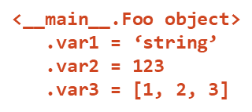
Python Serialization
Pickle Stack
0: \x80 PROTO 4
2: \x95 FRAME 60
11: \x8c SHORT_BINUNICODE '__main__'
21: \x8c SHORT_BINUNICODE 'Foo'
26: \x93 STACK_GLOBAL
27: ) EMPTY_TUPLE
28: \x81 NEWOBJ
29: } EMPTY_DICT
30: ( MARK
31: \x8c SHORT_BINUNICODE 'var1'
37: \x8c SHORT_BINUNICODE 'string'
45: \x8c SHORT_BINUNICODE 'var2'
51: K BININT1 123
53: \x8c SHORT_BINUNICODE 'var3'
59: ] EMPTY_LIST
60: ( MARK
61: K BININT1 1
63: K BININT1 2
65: K BININT1 3
67: e APPENDS (MARK at 60)
68: u SETITEMS (MARK at 30)
69: b BUILD
70: . STOP

Slide 24
Python Serialization
Not every Python object is picklable!
Doesn’t make sense to pickle stateful objects, such as…
File objects
Sockets
Database Connections
Defining the __reduce__ method tells pickle how to re-create an object
Notes:
Not every Python object can be pickled, particularly stateful objects. For example, it doesn’t make sense to pickle an open file object, a socket connection, or active database connections. This is for two reasons. The first is that it really doesn’t make sense to serialize and transmit, for example, an open file object to another system that likely doesn’t have the same filesystem. The second is that when pickle re-constructs the object, it doesn’t actually call the dunder __init__ method, which is the constructor. Instead, it creates a new instance of the object and then updates all of its local variables directly.
To help Python re-create these kinds of objects, a developer can define the dunder reduce method which is called when pickling the object to modify the default opcodes.

Slide 25
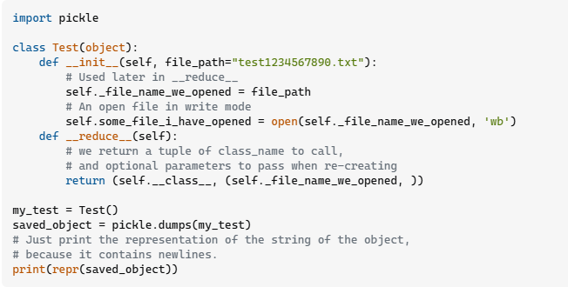
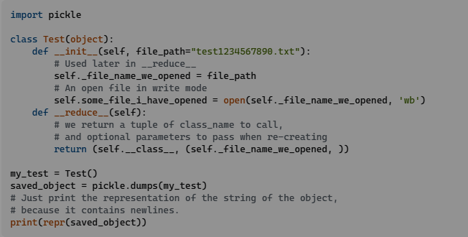
Python Serialization
VooDooNOFX (Stack Overflow, 2013)
Notes:
Here is a StackOverflow example of how the dunder reduce method is meant to be used. This object takes a file path as an argument and then >> opens the file for writing. Because the open file object can’t be pickled, the dunder reduce method is defined. The return value for this method is a tuple, and the first argument >> is a callable (a function or method). The next argument is a tuple that >> contains the arguments that will be passed to the callable. In this case, the callable is the class constructor and the argument is the file_path. When the >> constructor method is called, the open() method will be called on the file path, creating that open file object, effectively re-creating the original object’s state.

Slide 26
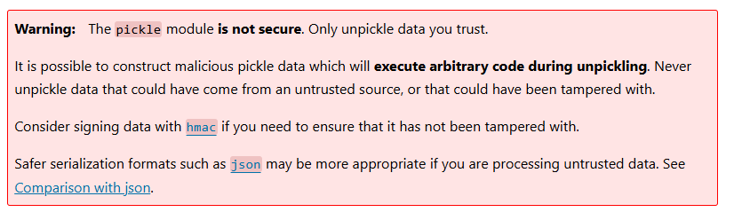
Python Serialization
__reduce__ can return any callable that Python knows about
exec() evaluate and run arbitrary Python code
Perform the following actions:
import os import the OS module
os.system() execute a system call
Python 3 Documentation, 2024
Notes:
The vulnerability is that dunder reduce can return any callable that the Python interpreter knows about. A way we can exploit this is by setting the callable to the builtin exec function. This will take a string that represents arbitrary Python code and execute it. If we craft the right Python code, we can get remote code execution. We will do this by importing the OS module, and calling os.system() which will execute arbitrary commands in a shell. This is a known issue, and the pickle documentation specifically highlights in a big red box that a developer should not unpickle untrusted objects.

Slide 27
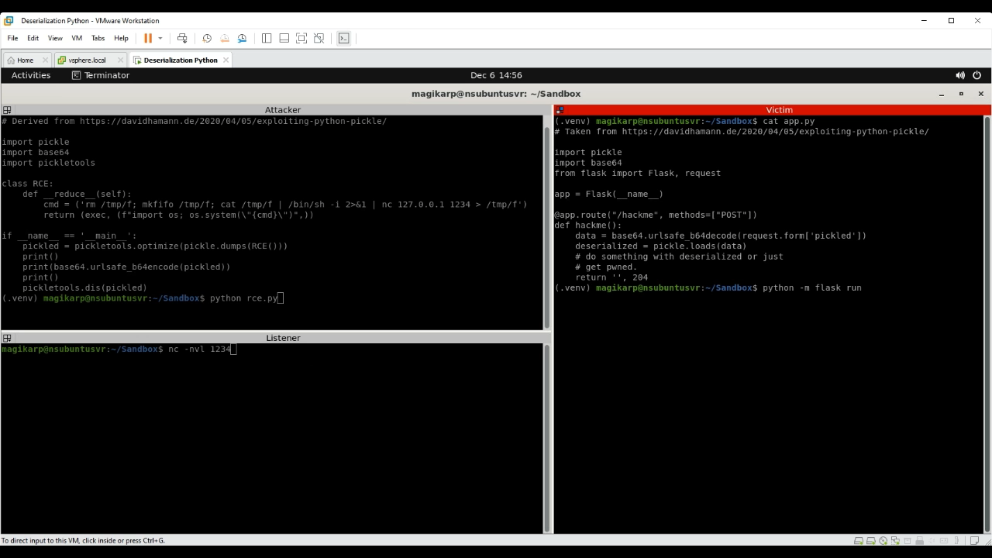
Python Serialization

Slide 28
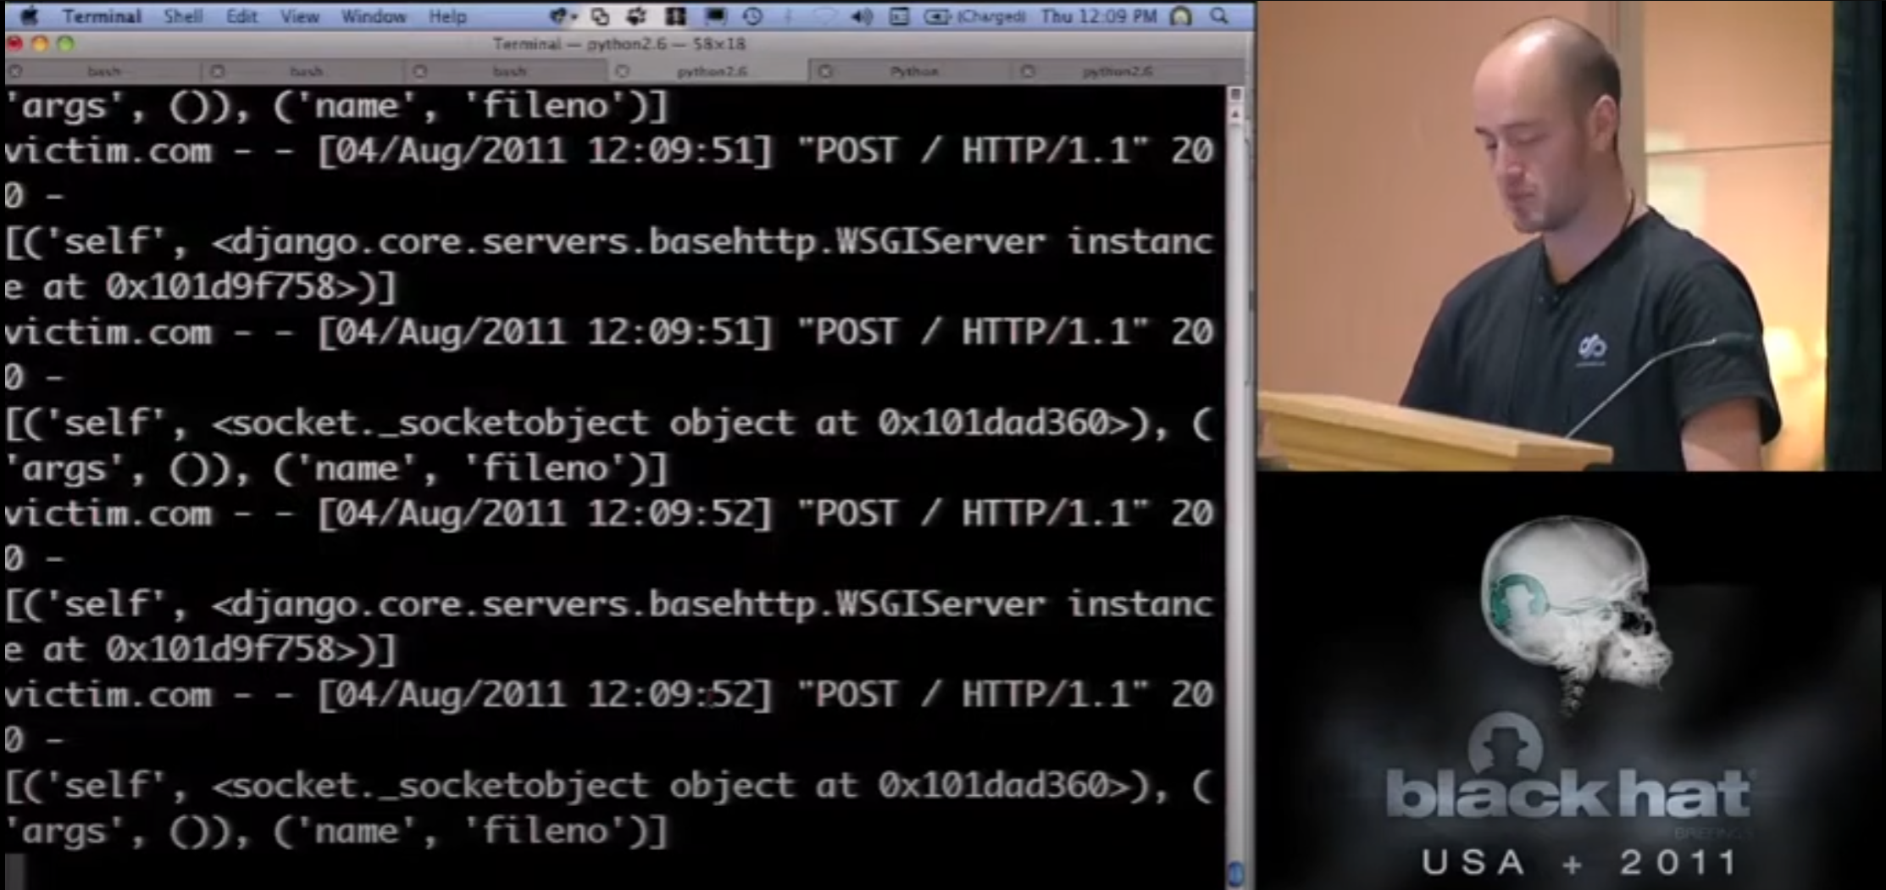
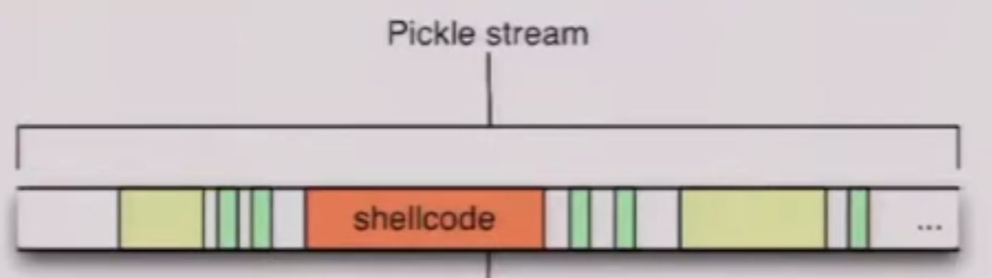
Python Serialization
Marco Slaviero, Black Hat 2011
Notes:
This example was fairly basic, but security researchers have been able to do some interesting things by directly injecting malicious commands into the pickle stream. In the screenshot here, a researcher was able to achieve persistence inside of a Django web server by injecting commands that enable remote debugging of the server. This allowed him to extract secret keys, which can then be used to forge requests on behalf of legitimate users.

Slide 29
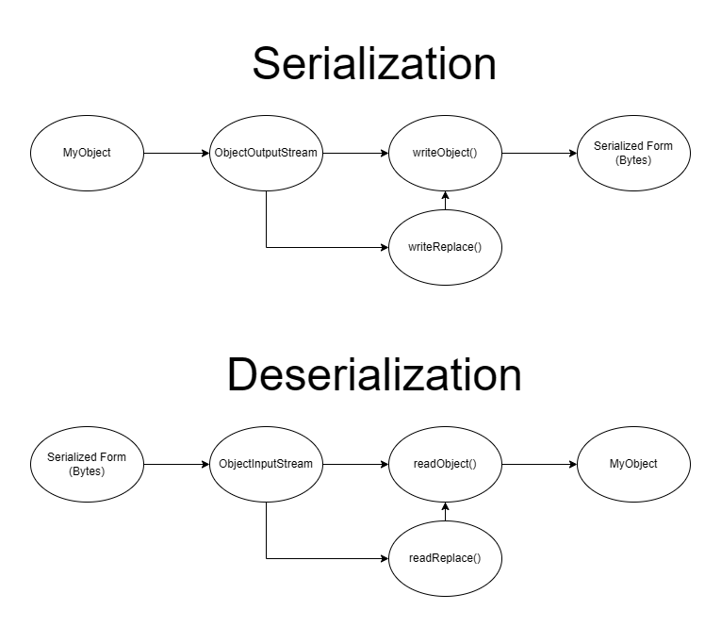
Java Serialization

Slide 30
Java Serialization

Slide 31
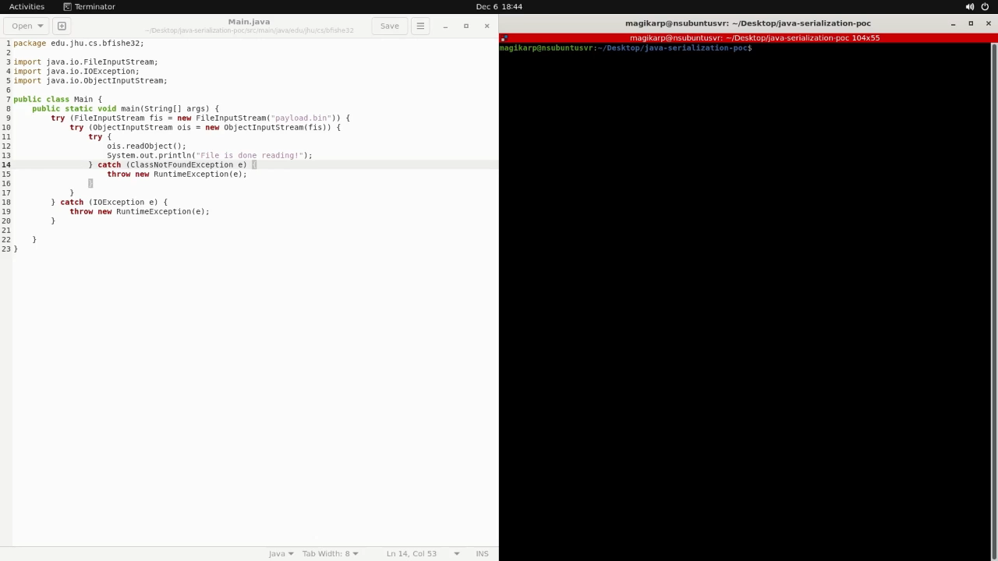
JAVA DEMO
Deserialization from Untrusted Sources Demo

Slide 32
Poor Defenses
Only use libraries that don't contain objects that can result in code execution.
Hard to determine which libraries these are. Java's Common Collections library has contained several of these and is one of the most widely used libraries.
Sometimes impossible. Python pickling can gain execution just from what's included in base Python.
Inspect the serialized object before deserialization, such as Python's pickletools.dis().
This is prone to error, missed edge-cases, etc.
Notes:
One common mistake in addressing deserialization vulnerabilities is relying on libraries that allow unsafe object deserialization. For example, Java’s Common Collections library has historically included objects that attackers can exploit for code execution. Similarly, Python’s pickle module can execute arbitrary code with base Python objects, making it inherently risky. Another poor practice is attempting to inspect serialized objects before deserialization, such as using Python's pickletools.dis(). While this approach can provide some insight, it is prone to error and often fails to catch complex or edge-case payloads. Finally, overlooking input validation entirely leaves applications vulnerable to malformed or malicious data, particularly when dealing with untrusted sources like network inputs or uploaded files.

Slide 33
Good Defenses
Use serialization libraries that deserialize to a specific object rather than to any object.
This prevents immediate code execution from deserialization as long as the programmer doesn't pick a bad object.
Easy to do. Most times, serialization and deserialization is done to a specific format, so force deserialization to be performed into that format. A config file, for example, contains a specific set of keys, so we only care about deserializing into that exact format.
Example: Java's GSON (deserializes to a specified class) or Python's json (deserializes to a harmless dictionary) to deserialize from JSON.
Check data before use.
Even using safer libraries, one must ensure the data contained within makes sense and fail gracefully if it doesn't.
Notes:
To defend against these risks, developers should use serialization libraries that enforce deserialization into specific, predefined object types. For instance, Python’s json module converts data into dictionaries, while Java’s GSON library restricts deserialization to specified classes, making it harder for attackers to execute arbitrary code. It’s also crucial to validate deserialized data to ensure it meets expected formats and values. For example, if deserializing a configuration file, verify that all required keys are present and that the data types match the expected schema. Additionally, systems should be designed to handle invalid or suspicious data gracefully, such as logging errors and rejecting untrusted inputs. These practices help reduce the attack surface and mitigate potential vulnerabilities.

Slide 34
Conclusion
Serialization and deserialization is extremely common and necessary.
Deserialization from untrusted sources and dangerous, it should be handled with care, else one risks anything up to code execution!
Use serialization formats that support deserializing to a safe representation and/or to a specific class or structure.
Ensure deserialized data is safe, it's as dangerous as user input because it is.
Notes:
Serialization and deserialization are vital tools for modern software, enabling seamless data storage and communication. However, deserialization from untrusted sources poses significant risks, including the potential for system compromise. To address this, developers must adopt secure serialization formats, enforce strict deserialization policies, and validate all incoming data. Ultimately, deserialized data should be treated with the same caution as user input, ensuring it doesn’t become a vector for exploitation. By implementing these safeguards, we can build systems that are not only functional but also secure and resilient to attacks.

Slide 35
References
D. Hamann, "Exploiting Python pickles," 05 April 2020. [Online]. Available: https://davidhamann.de/2020/04/05/exploiting-python-pickle/. [Accessed 05 December 2024].
blackhattish, "BlackHat 2011 - Sour Pickles, A serialised exploitation guide in one part," 13 June 2012. [Online]. Available: https://www.youtube.com/watch?v=HsZWFMKsM08. [Accessed 05 December 2024].
Python Foundation, "cpython," 05 December 2024. [Online]. Available: https://github.com/python/cpython/tree/main. [Accessed 05 December 2024].
VooDooNOFX, "What's the exact usage of __reduce__ in Pickler," 09 November 2013. [Online]. Available: https://stackoverflow.com/questions/19855156/whats-the-exact-usage-of-reduce-in-pickler. [Accessed 05 December 2024].
Cerin, "How to create a class instance without calling initializer?," 06 February 2013. [Online]. Available: https://stackoverflow.com/questions/2168964/how-to-create-a-class-instance-without-calling-initializer. [Accessed 05 December 2024].
E. Sangaline, "What’s so dangerous about pickles?," 17 october 2017. [Online]. Available: https://intoli.com/blog/dangerous-pickles/. [Accessed 05 December 2024].
Python Software Foundation, "pickle — Python object serialization," [Online]. Available: https://docs.python.org/3/library/pickle.html. [Accessed 05 December 2024].
dogboy21, "serializationisbad," 16 March 2024. [Online]. Available: https://github.com/dogboy21/serializationisbad. [Accessed 05 December 2024].
breenmachine, "What Do WebLogic, WebSphere, JBoss, Jenkins, OpenNMS, and Your Application Have in Common?," 06 November 2015. [Online]. Available: https://foxglovesecurity.com/2015/11/06/what-do-weblogic-websphere-jboss-jenkins-opennms-and-your-application-have-in-common-this-vulnerability. [Accessed 05 December 2024].
DoctorDrive, "ysoserial," 30 March 2024. [Online]. Available: https://github.com/frohoff/ysoserial/commits/master/. [Accessed 05 December 2024].
Ewoud, "Can't execute jar- file: "no main manifest attribute"," 13 March 2012. [Online]. Available: https://stackoverflow.com/questions/9689793/cant-execute-jar-file-no-main-manifest-attribute. [Accessed 05 December 2024].
bianca, "Building a fat jar using maven," 25 April 2013. [Online]. Available: https://stackoverflow.com/questions/16222748/building-a-fat-jar-using-maven. [Accessed 05 December 2024].
The Apache Software Foundation, "Apache Maven Project," 15 March 2024. [Online]. Available: https://maven.apache.org/plugins/maven-assembly-plugin/usage.html. [Accessed 05 December 2024].

Slide 36
Copyright The Johns Hopkins University 2024. All rights reserved.

